Slide 1
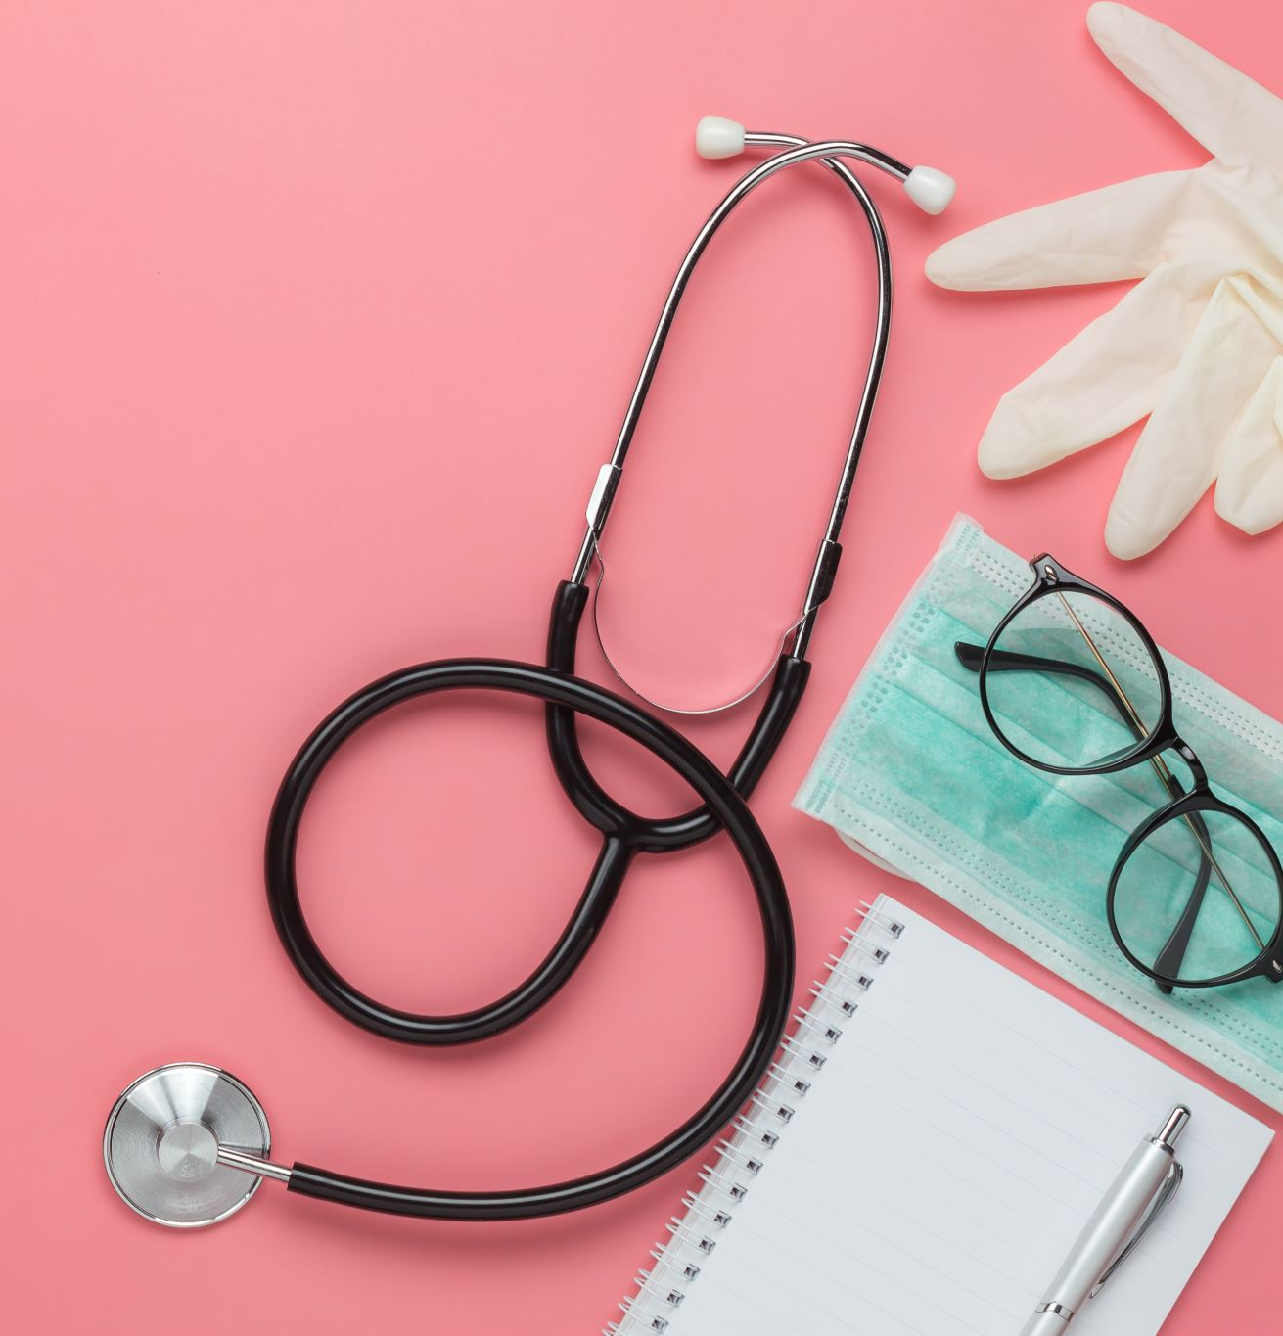
Medical Image to Text Report Generation
Devanshu Subhashbhai Gohil

Slide 2

Background - The Radiology Workflow Challenge
Current Radiology Reporting Process:
Over 3.6 billion radiological exams performed annually worldwide
Average radiologist reads 50-100 studies daily
Each chest X-ray report takes 5-10 minutes to dictate and finalize
Report creation accounts for 36% of radiologist work time
Key Challenges:
Growing imaging volumes (+5-7% annually)
Global radiologist shortage (critical in 83 countries)
Reporting backlogs affecting timely patient care
Variability in report quality and structure
Cost Implications: Delayed reporting contributes to $1.6B in annual healthcare costs

Slide 3

Motivation - AI-Assisted Reporting Solution
Clinical Value Proposition:
Automated draft generation reduces reporting time by 23-37%
AI pre-screening can prioritize urgent findings
Structured reporting improves clinical decision support
Consistent terminology enhances communication with referring physicians
Technical Innovation:
Combining computer vision for image feature extraction
Natural language generation for coherent medical narratives
Cross-modal attention linking visual findings to textual descriptions
Unique Approach: End-to-end trainable system that maintains clinical accuracy

Slide 4

Clinical Relevance
Healthcare Impact:
~3 billion people rely on radiology services globally
Shortage of radiologists, especially in underserved areas
Growing imaging volume creates reporting backlogs
Practical Applications:
Preliminary report drafting
Prioritization of urgent cases
Quality assurance and second opinions
Teaching and training

Slide 5
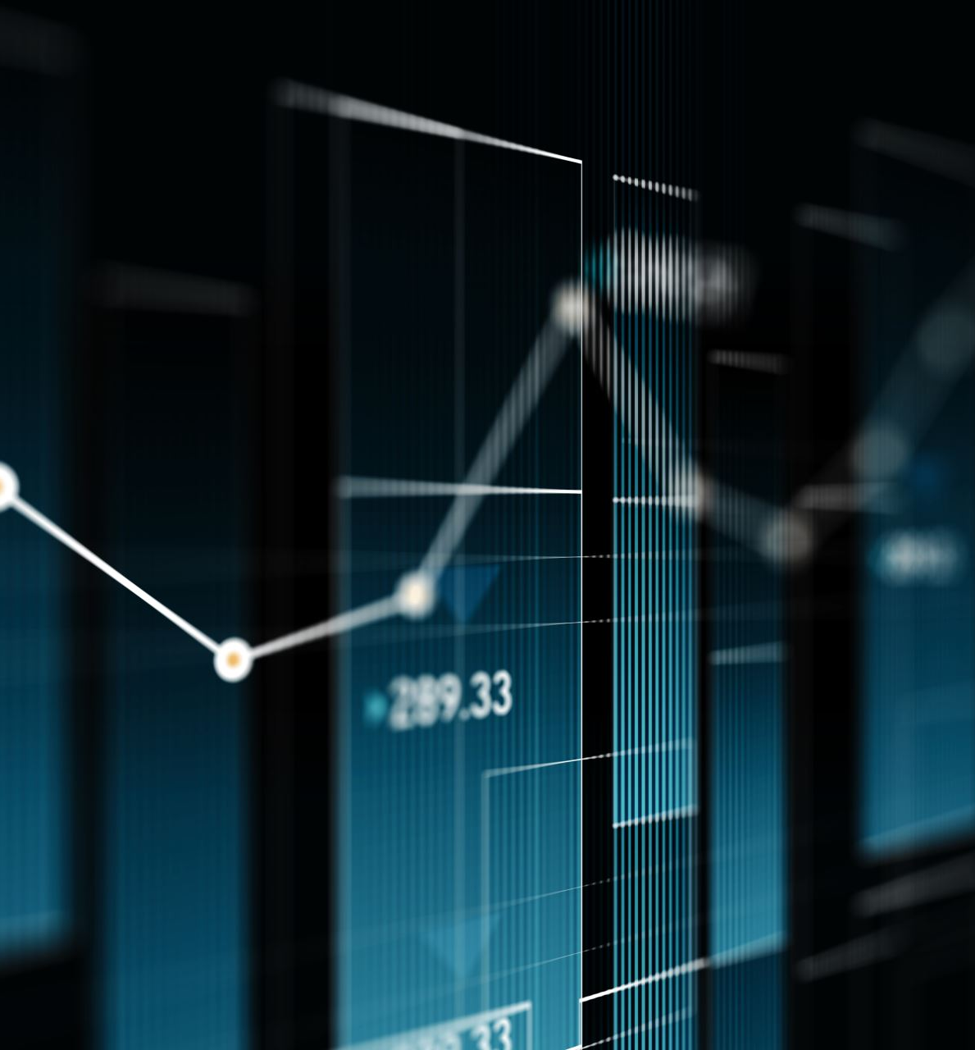
Methodology Overview
Dataset:
Indiana Chest X-ray dataset with paired images and reports
Preprocessing:
Image normalization and resizing
Report text cleaning and tokenization
Cross-Validation:
70% training, 10% validation, 20% testing
General Architecture:
Vision encoder for feature extraction
Projection layer to align dimensions
Text decoder for report generation
Evaluation Metrics: BLEU-1/4, ROUGE scores, normal/abnormal classification

Slide 6
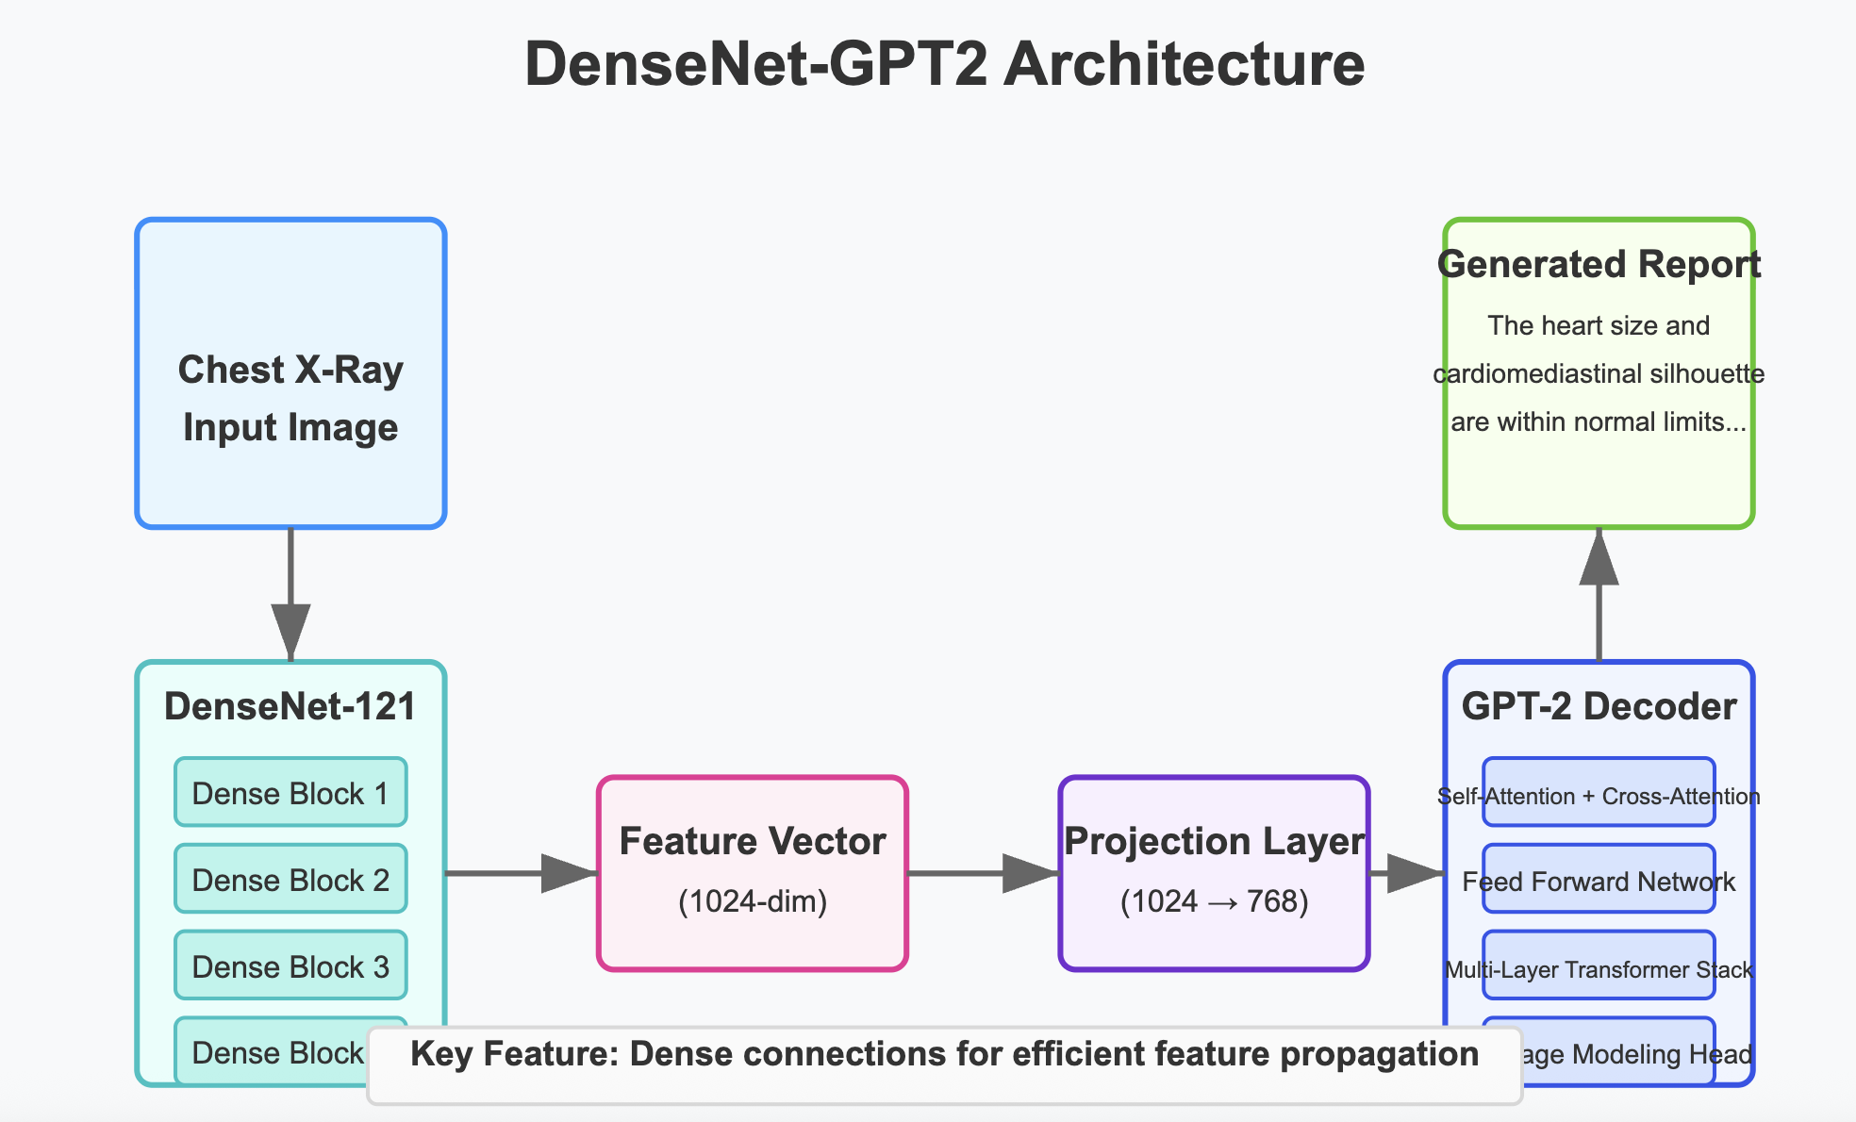
Architecture – DenseNet+GPT2
Visual Encoder:
DenseNet121 (pretrained on ImageNet) Dense connections for efficient feature propagation
1024-dimensional feature vectors
Text Decoder:
GPT-2 language model
Autoregressive generation
Cross-attention mechanism
Training Details:
Batch size: 16
Learning rate: 5e-5
Optimizer: AdamW
Loss function: Cross-entropy

Slide 7
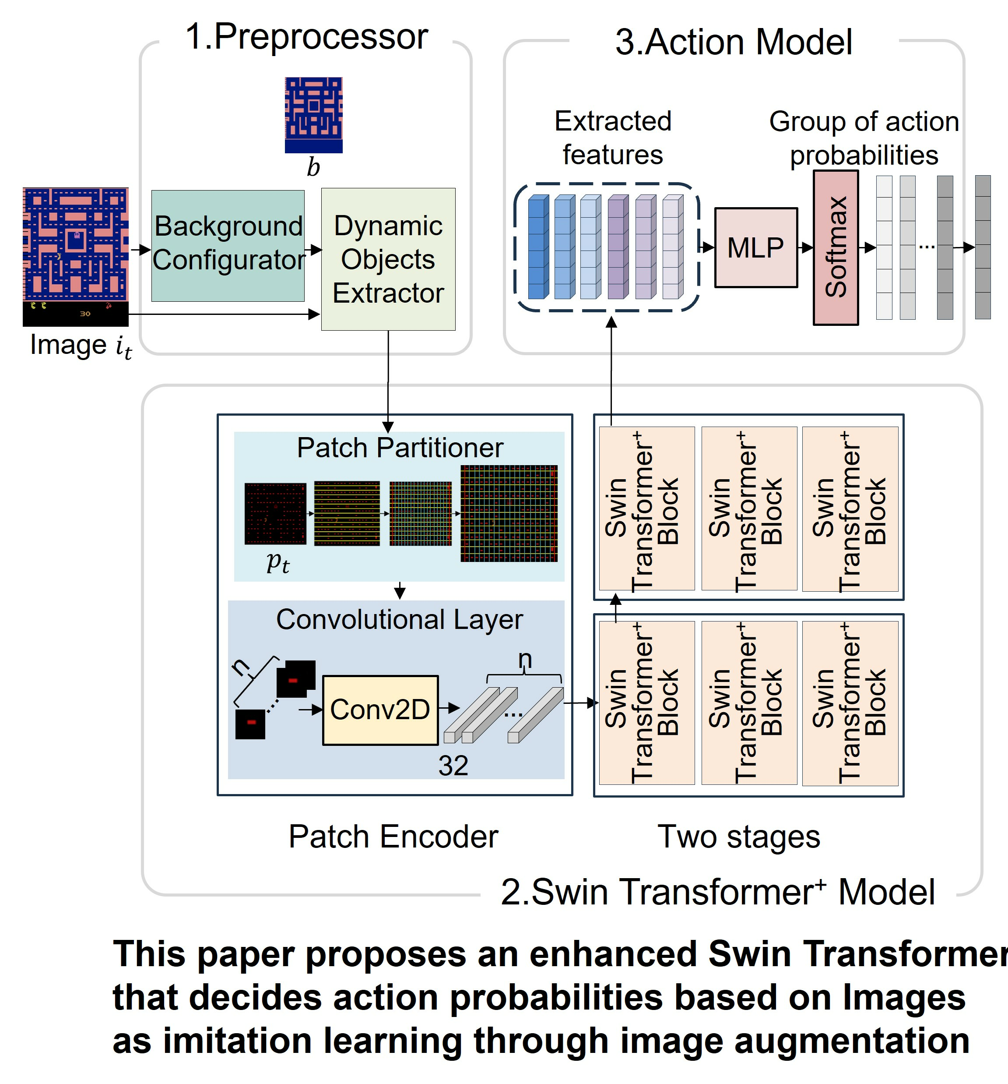
Architecture - Swin-GPT2
Visual Encoder:
Swin Transformer (pretrained on ImageNet-22k) Hierarchical feature extraction with shifted windows
Efficiently handles high-resolution images
Text Decoder:
GPT-2 language model
Similar setup as DenseNet-GPT2 approach
Training Details:
Batch size: 32
Learning rate: 1e-4
Optimizer: AdamW with cosine annealing
Epochs: 15
Loss function: Cross-entropy

Slide 8
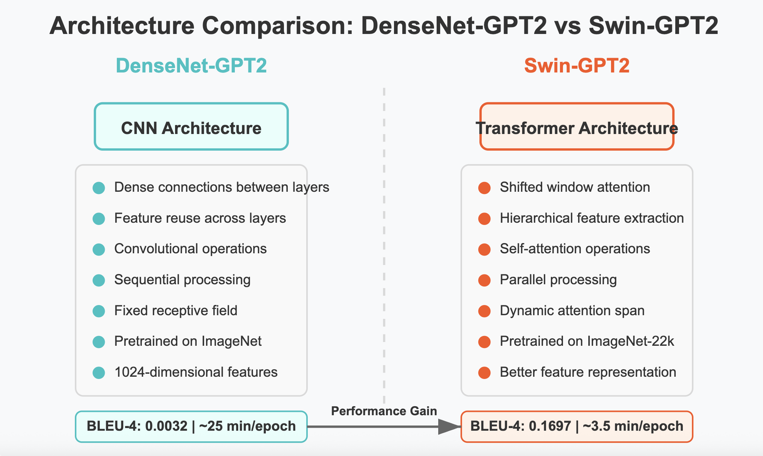

Slide 9
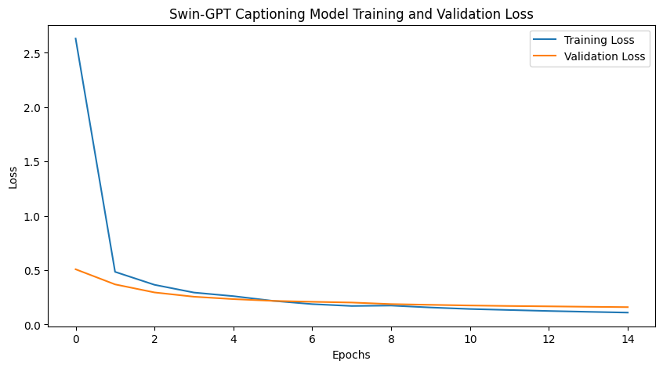
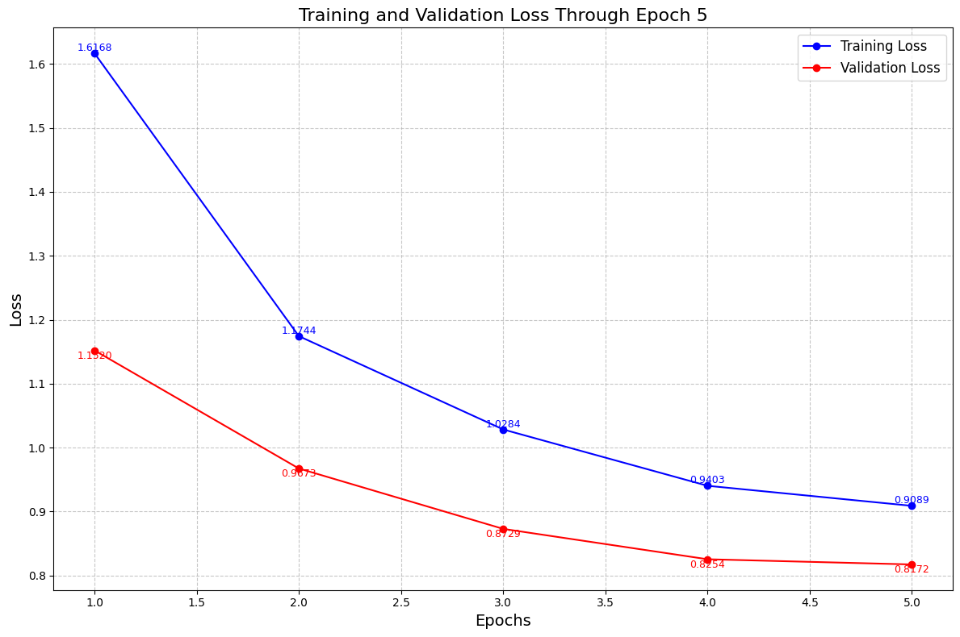
Results - Training Performance
Training & Validation Loss:
DenseNet-GPT2: Initial loss ~1.6, final loss ~0.9
Swin-GPT2: Initial loss ~2.6, final loss ~0.16
Convergence:
DenseNet-GPT2: Gradual decline with some fluctuation
Swin-GPT2: Faster convergence with smoother decline
Training Time:
DenseNet-GPT2: ~25 minutes per epoch
Swin-GPT2: ~3.5 minutes per epoch

Slide 10
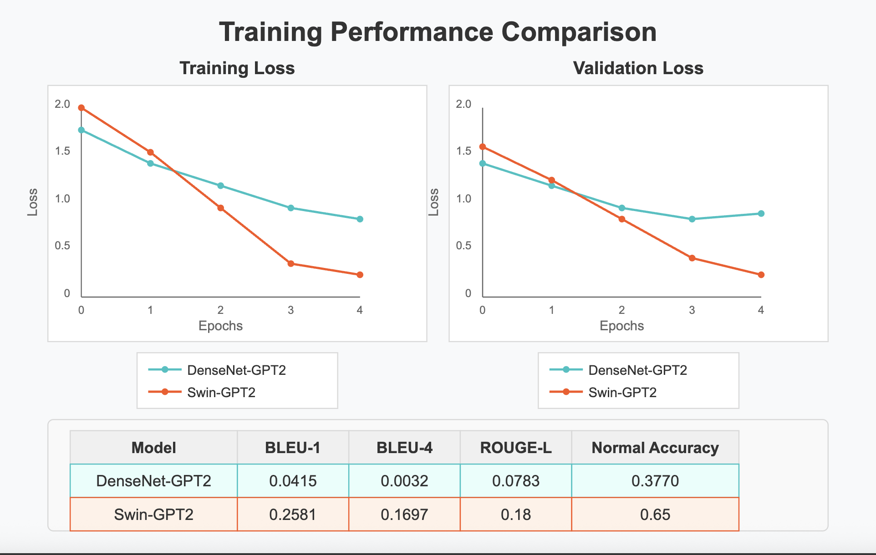

Slide 11
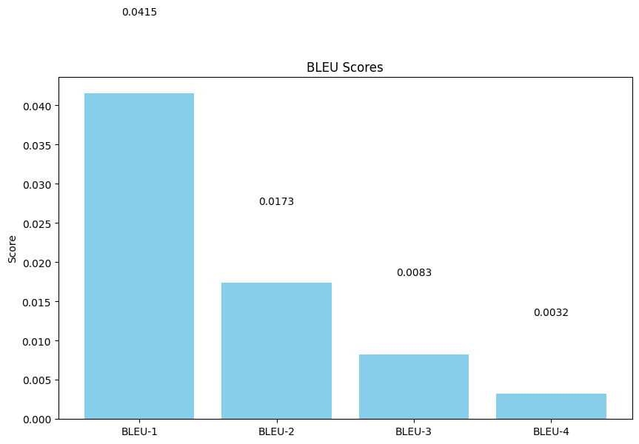
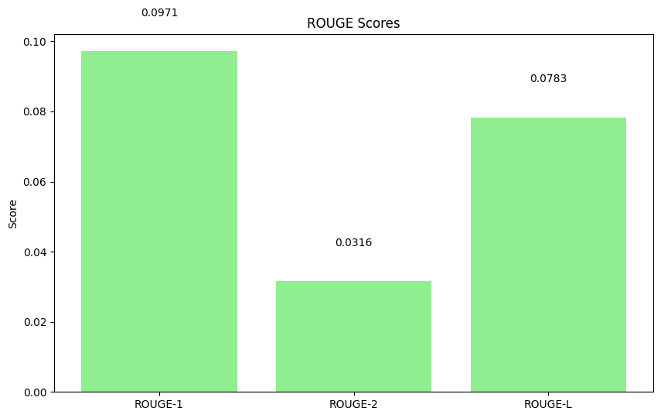
Results - Evaluation Metrics
BLEU-1 Score (unigram overlap):
DenseNet-GPT2: 0.0415
Swin-GPT2: 0.2581
BLEU-4 Score (4-gram overlap):
DenseNet-GPT2: 0.0032
Swin-GPT2: 0.1697
ROUGE-L Score (longest common subsequence):
DenseNet-GPT2: 0.0783
Swin-GPT2: ~0.18
Normal/Abnormal Classification: DenseNet-GPT2: 0.377 accuracy

Slide 12
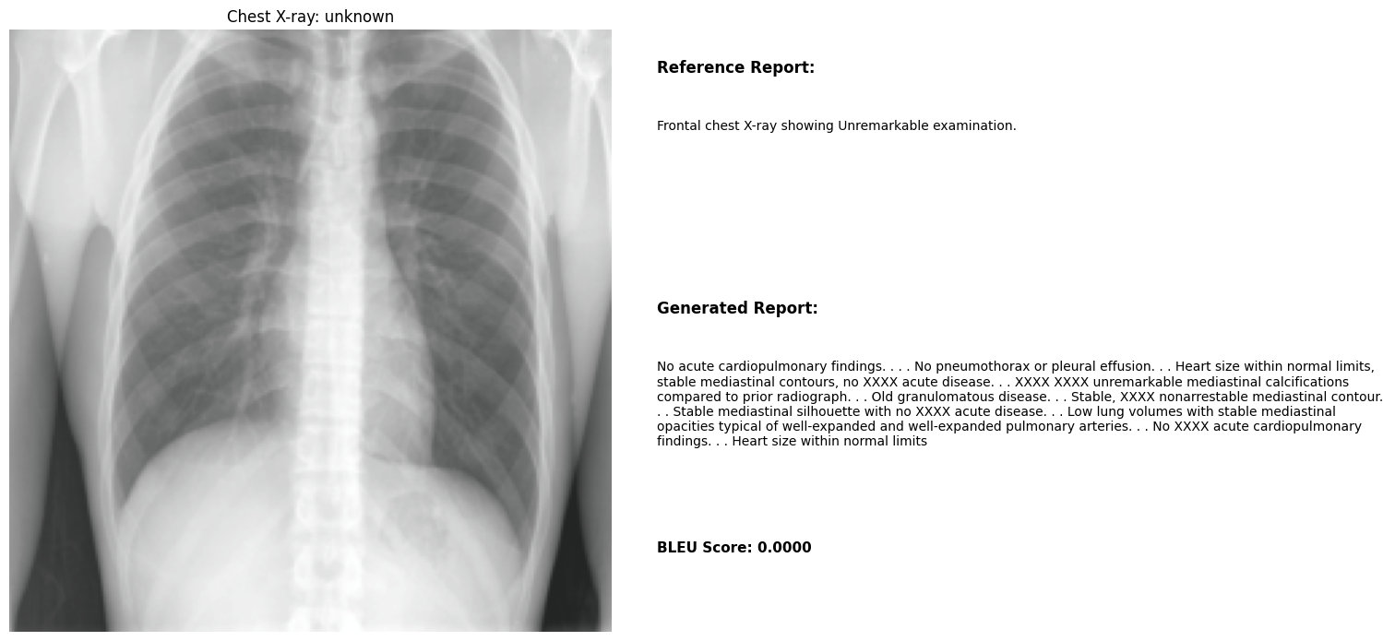
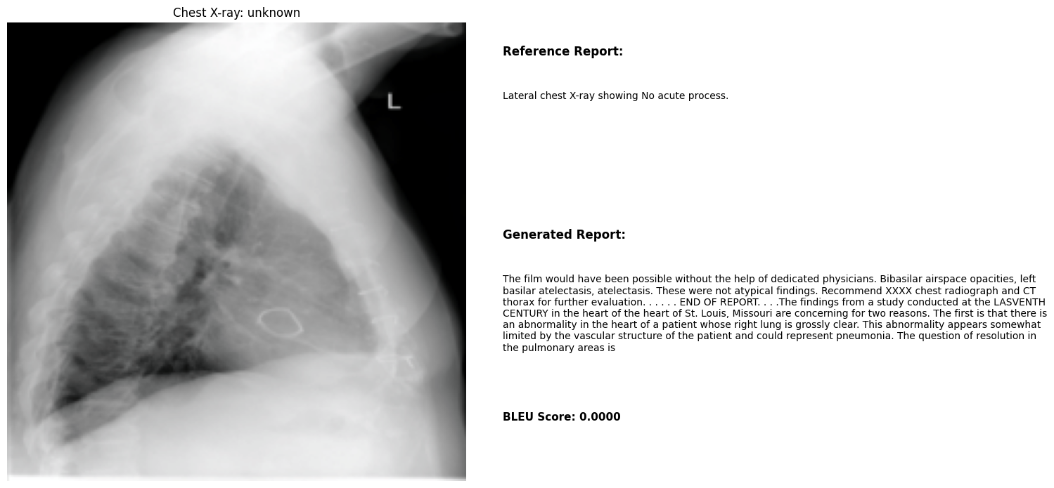
CNN+GPT: Sample Report Generation

Slide 13
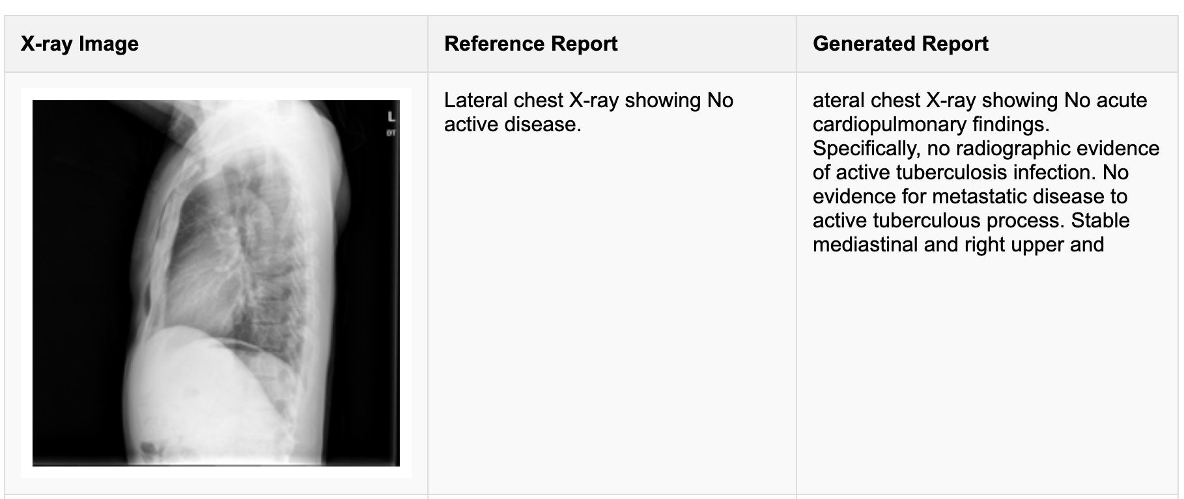

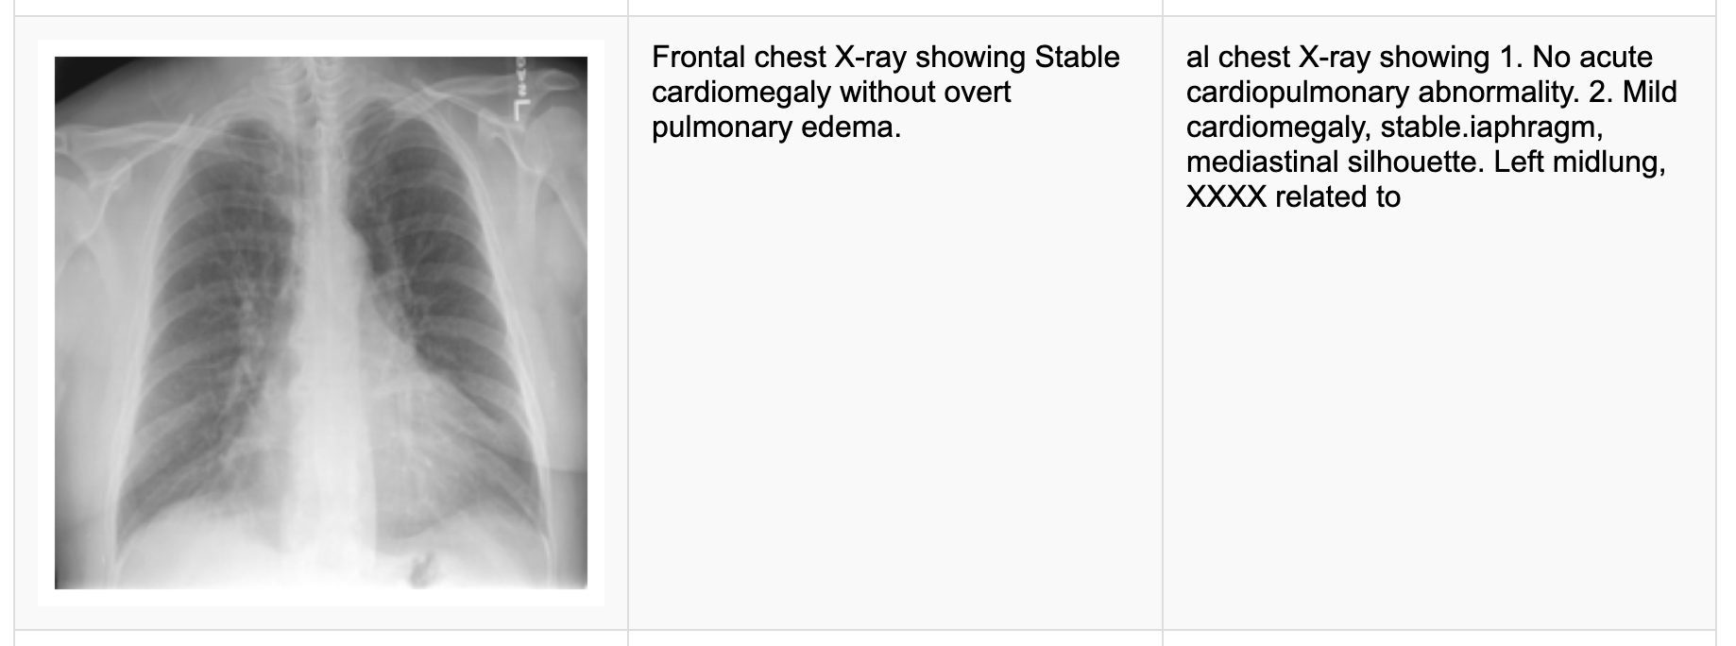
Swin+GPT: Sample Report Generation

Slide 14
Conclusion and Future Directions
Key Findings:
Swin-GPT2 significantly outperforms DenseNet-GPT2 across all metrics
Vision Transformers capture more relevant radiological features than CNNs
Higher batch size and learning rate benefits the Transformer architecture
Future Directions:
Medical domain fine-tuning of language models
Incorporating structured medical knowledge
Visual attention mechanisms for explainability
Multi-view integration (frontal and lateral X-rays)
Clinical validation with radiologists

Slide 15

Thank You

